Slide 1
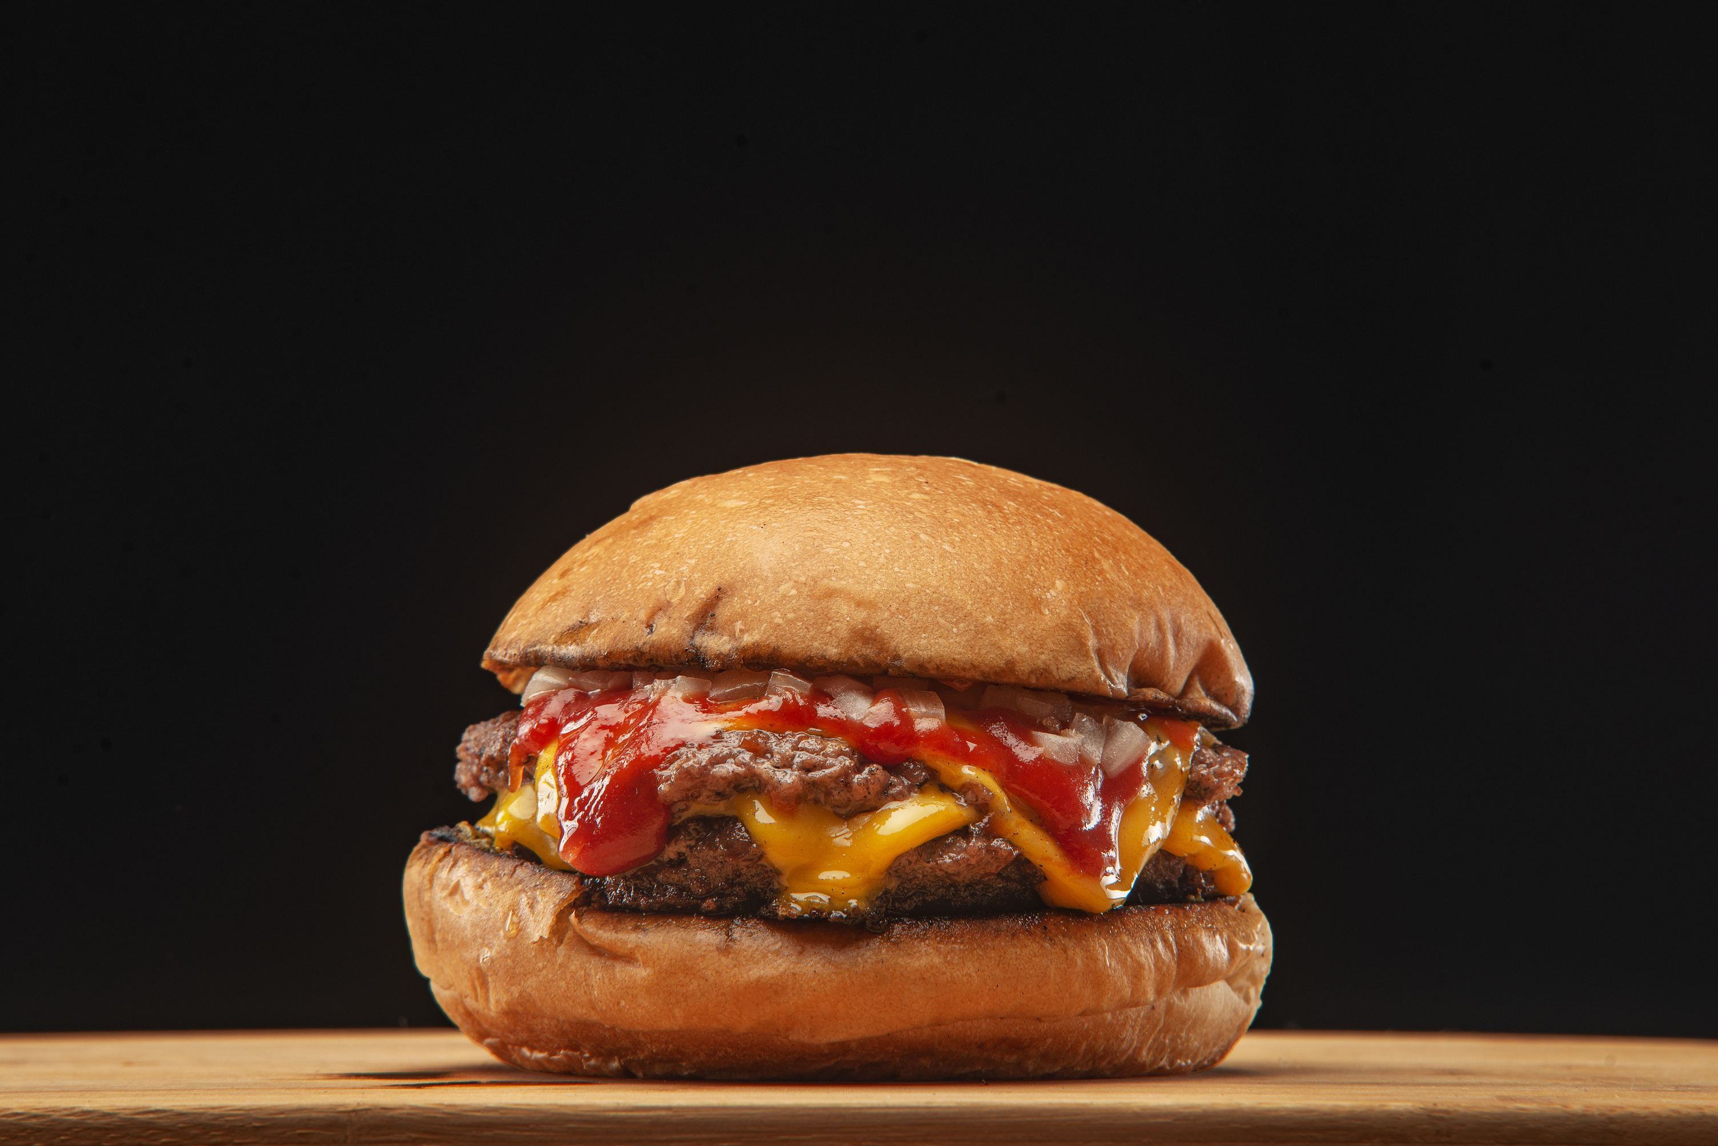



QUICKGRILL
BURGER ORDERING SYSTEM
PRESENTATION
PREPARED FOR : MISS WAN ATHIRAH BINTI WAN ENDUT

Slide 2







QUICKGRILL
MEET OUR TEAM
FARIS
ILHAM
AIMAN
ASYRAF
ALEXANDER
FRONT END DEVELOPER
SYSTEM ANALYST
PROJECT MANAGER
SYSTEM DESIGN
BACK END DEVELOPER

Slide 3

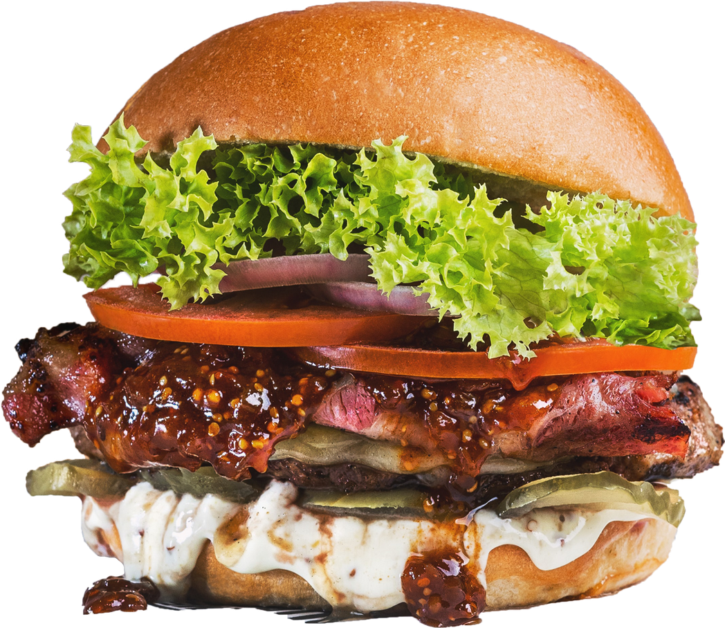

PROJECT BACKGROUND
The modern food and beverage industry is rapidly evolving, with increasing demand for convenience and accessibility. To address these needs, the proposed system integrates burger ordering, stall vendor management, and administrative oversight into a single platform. Customers can conveniently browse menus, order burgers, add items to their cart, and make payments. Aspiring stall vendors can use the system to register and manage their stalls, add menus, and monitor orders. Administrators oversee the platform’s operations, including approving stall applications and managing users and stalls. This system aims to bridge the gap between food enthusiasts, small business owners, and system administrators, fostering a streamlined and efficient experience.

Slide 4
PROBLEM STATEMENT
The food and beverage industry faces significant challenges in providing efficient and seamless experiences for both customers and stall vendors. Customers often encounter difficulties with manual ordering systems that lack convenience, flexibility, and real-time updates on menus and availability. Stall vendors, particularly small-scale entrepreneurs, struggle to manage their stalls effectively due to the absence of unified tools for registering stalls, managing menus, and tracking orders. Additionally, administrators face time-consuming and error-prone processes when managing user accounts, approving stall applications, and overseeing platform operations. These challenges highlight the need for an integrated system that connects customers, stall vendors, and administrators, fostering a streamlined and efficient ecosystem for all stakeholders.

Slide 5

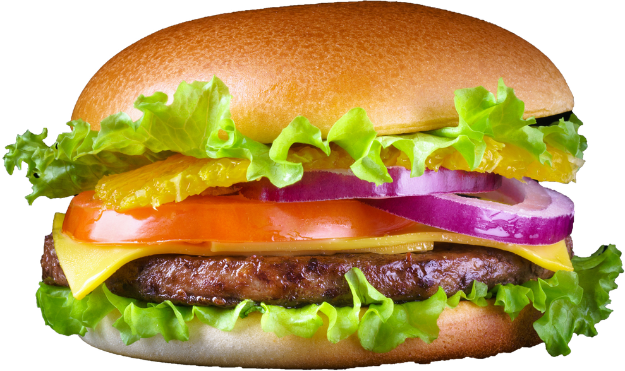


PROJECT SCOPE
Ability to browse menus, place orders online, track order status, and make secure payments.
Tools for managing customer orders and improving service efficiency.
System management, data entry, and monitoring of stall and customer activity.

Slide 6
OBJECTIVES
To Develop a Unified System: Create an integrated platform that connects customers, stall vendors, and administrators, ensuring smooth communication and operations.
To Enhance Customer Experience: Allow customers to browse menus, add items to their cart, make payments, and enjoy a user-friendly burger ordering experience.
To Empower Stall Vendors: Provide stall vendors with tools to register stalls, add menus, view stall orders, and manage their profiles efficiently.
To Streamline Administrative Tasks: Enable administrators to manage users, stalls, and approve stall applications with minimal effort.
To Ensure Secure Access: Implement login and logout features for all users to ensure secure access to the system.

Slide 7

Data Gathering
To identify and validate the requirements of the Burger Ordering System. The process for data gathering is
PROJECT METHODOLOGY
System Design
To create a sketch for the Burger Ordering System that meets user requirements. The process for system design is
System Development
To build a functional Burger Ordering System. The process for system development is

Slide 8
ANALYSIS PHASE
The analysis phase focuses on understanding the system requirements. Customers need to browse menus, customize burgers, place orders, and make payments. Restaurants must manage menus, track orders, and inventory.
IMPLEMENTATION PHASE
The implementation phase involves building and deploying the system. Front-end development uses tools like HTML/CSS for responsive design. The back-end uses frameworks like php to handle requests and APIs. A database like MySQL stores system data. The system is deployed on a cloud platform, ensuring reliability and monitoring for maintenance.
DESIGN PHASE
The design phase creates the system blueprint. A multi-tier architecture is proposed: the front-end (website/app), back-end (server for logic), and database (to store orders, users, and menu data). Tables like Users, Menu Items, Orders, and Payments will be created. Mockups for the user interface include home, menu, and checkout pages.

Slide 9
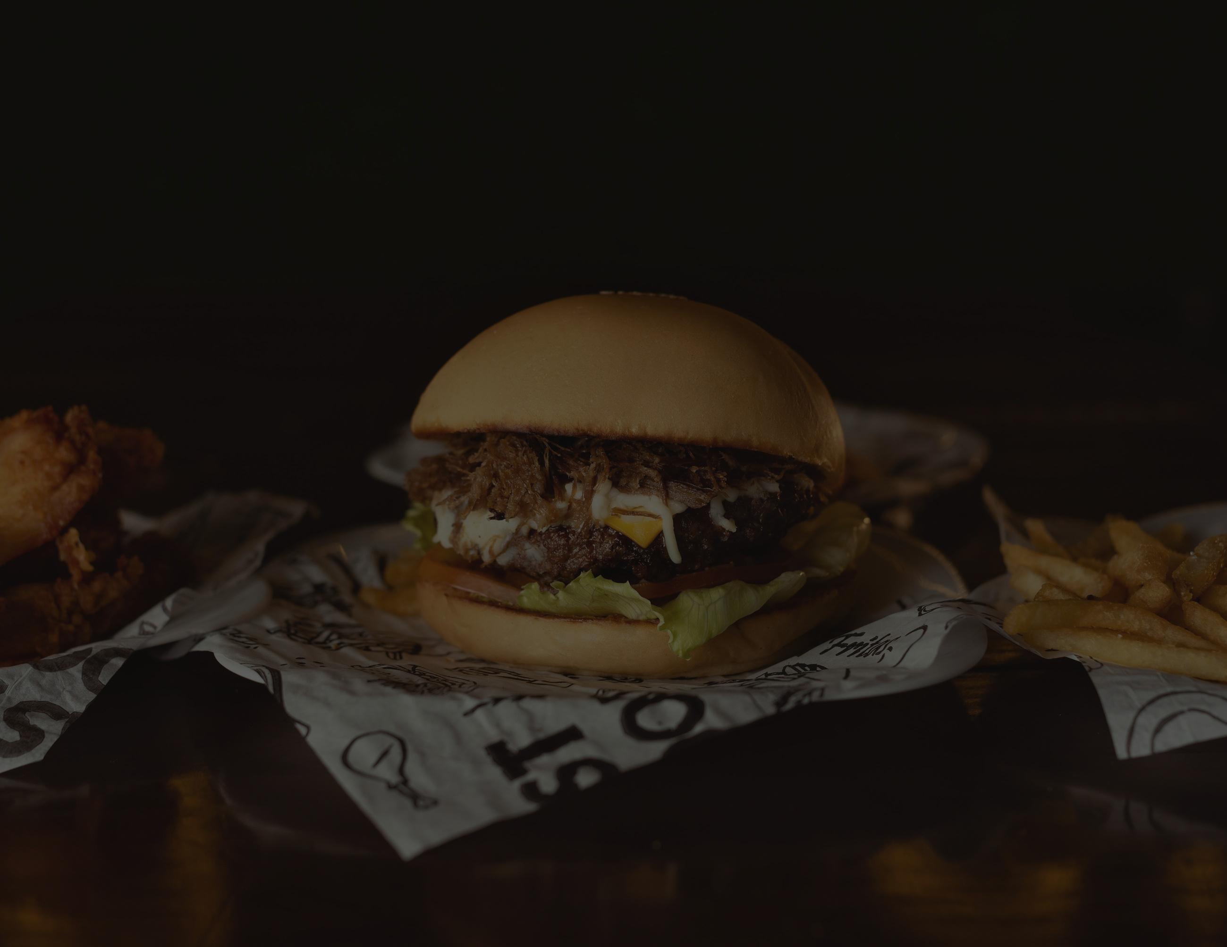
Process | SEMESTER 5 (OCT 2024 - FEB 2025) | SEMESTER 5 (OCT 2024 - FEB 2025) | SEMESTER 5 (OCT 2024 - FEB 2025) | SEMESTER 5 (OCT 2024 - FEB 2025) | SEMESTER 5 (OCT 2024 - FEB 2025) | SEMESTER 5 (OCT 2024 - FEB 2025) | SEMESTER 5 (OCT 2024 - FEB 2025) | SEMESTER 5 (OCT 2024 - FEB 2025) | SEMESTER 5 (OCT 2024 - FEB 2025) | SEMESTER 5 (OCT 2024 - FEB 2025) | SEMESTER 5 (OCT 2024 - FEB 2025) | SEMESTER 5 (OCT 2024 - FEB 2025) | SEMESTER 5 (OCT 2024 - FEB 2025)
Process | 4 | 5 | 6 | MID SEM BREAK | 7 | 8 | 9 | 10 | FESTIVAL HOLIDAY | 11 | 12 | 13 | 14
analysis phase
consult the project title, objectives, scope and initial feedback
functional and non functional - requirement consultation
enterprise modeling (identify main entities and their relationship)
design phase
design use case diagram
design wireframes
design entity relationship diagram
proposal presentation
proposal correction submission
implementation phase
front end development
back end dedvelopment
presentation implementation progress
progress implementation and final report
final report submission and system presentation

Slide 10
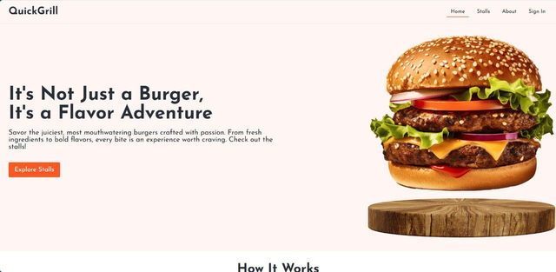
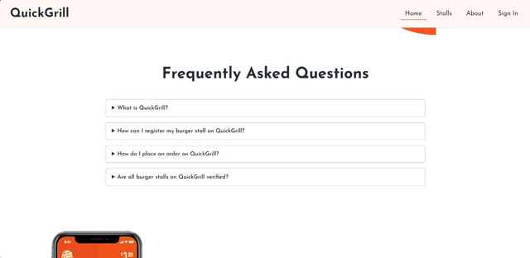
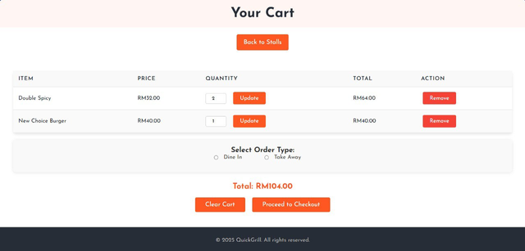
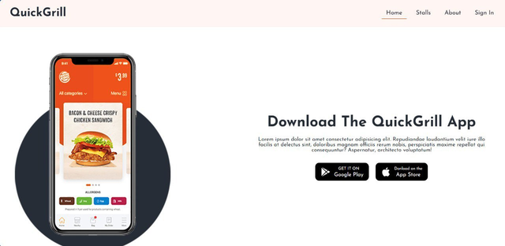
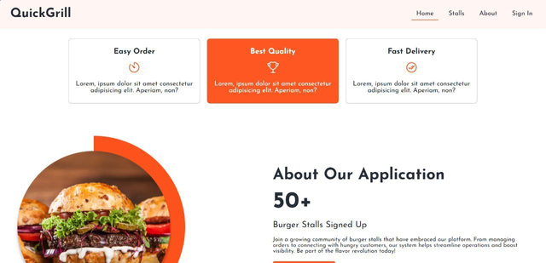
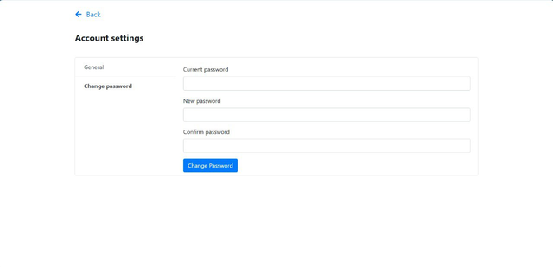
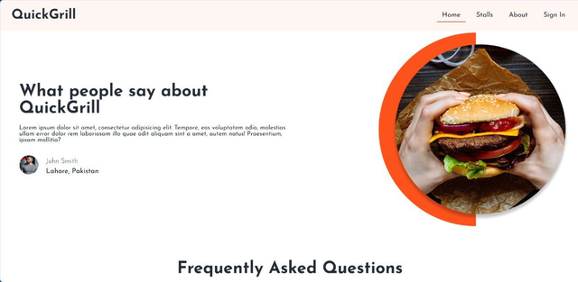
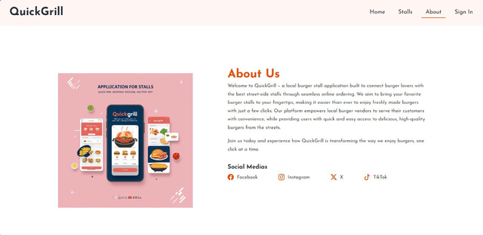
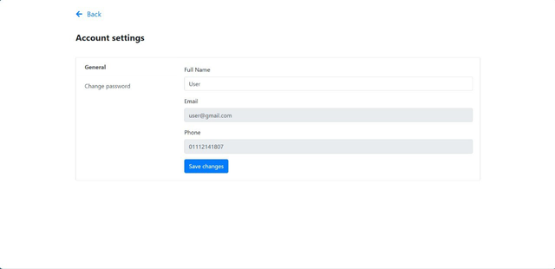

Slide 11
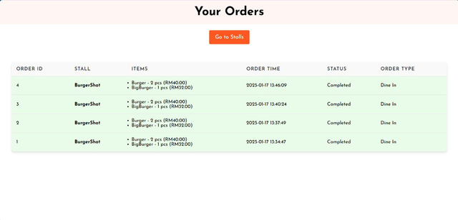
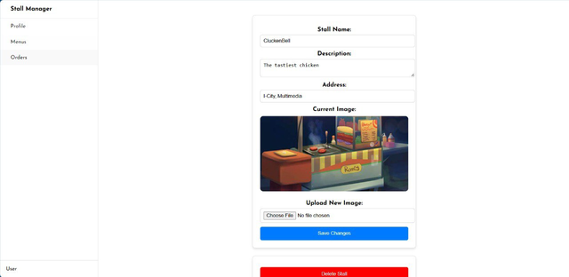
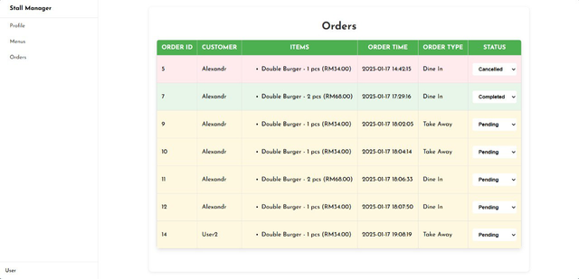
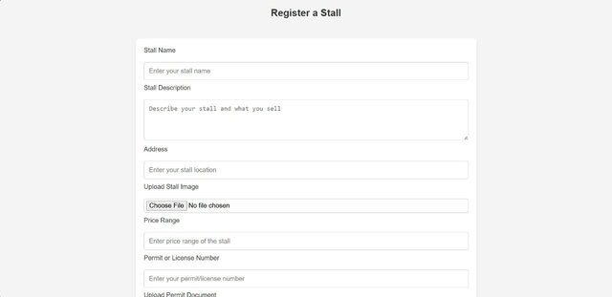
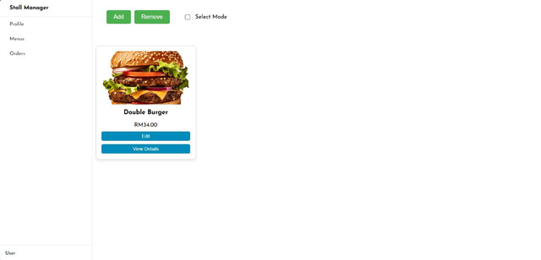
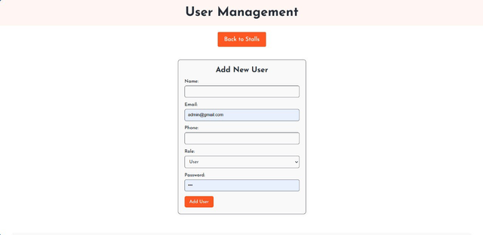
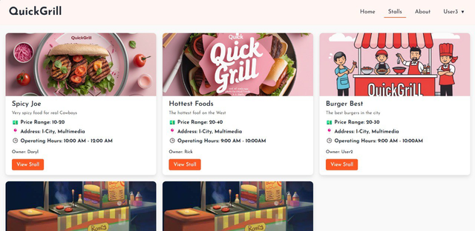
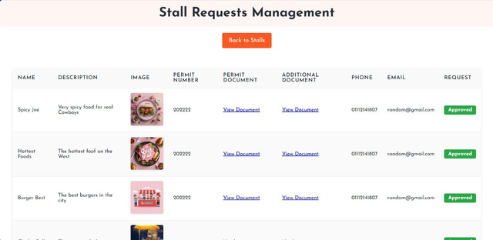
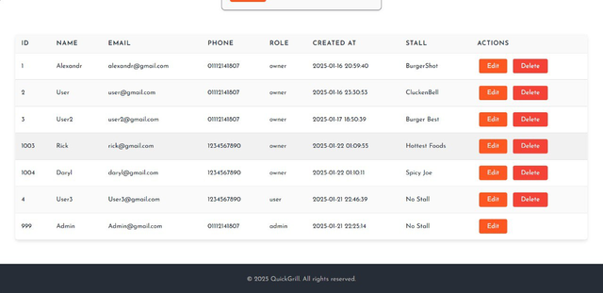

Slide 12
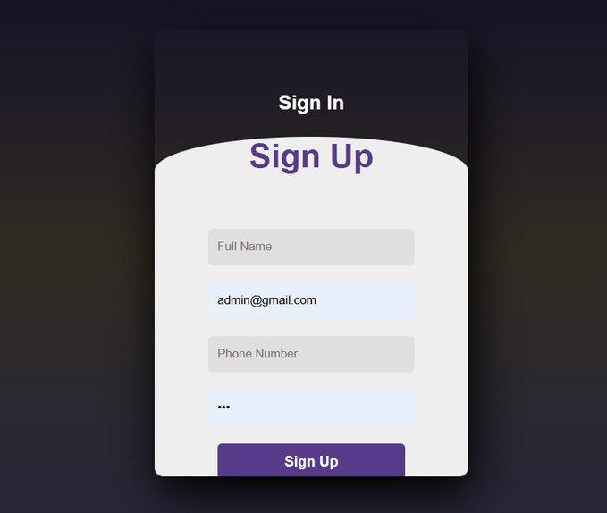
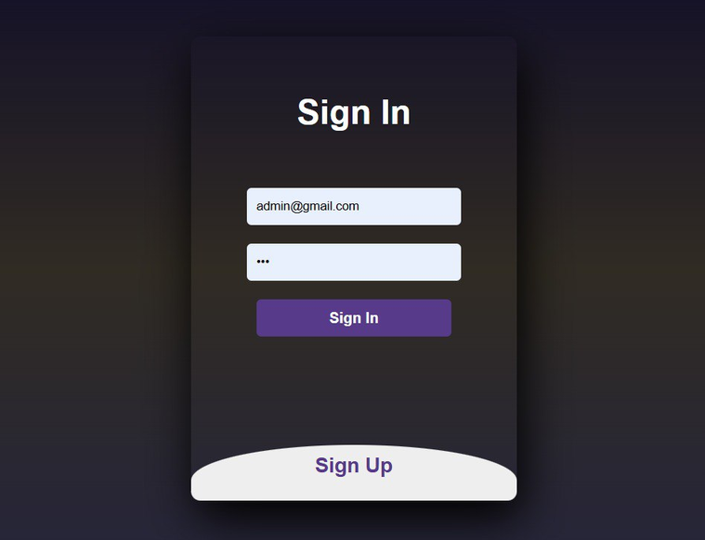

Slide 13
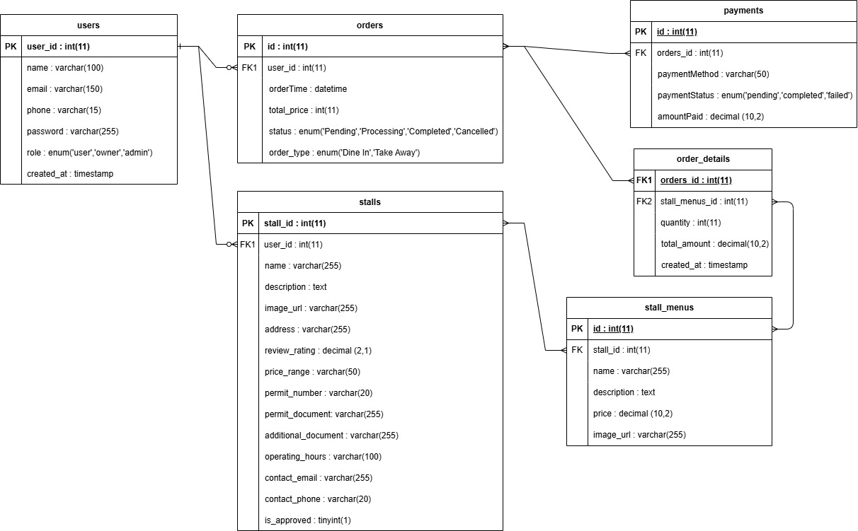
ERD

Slide 14
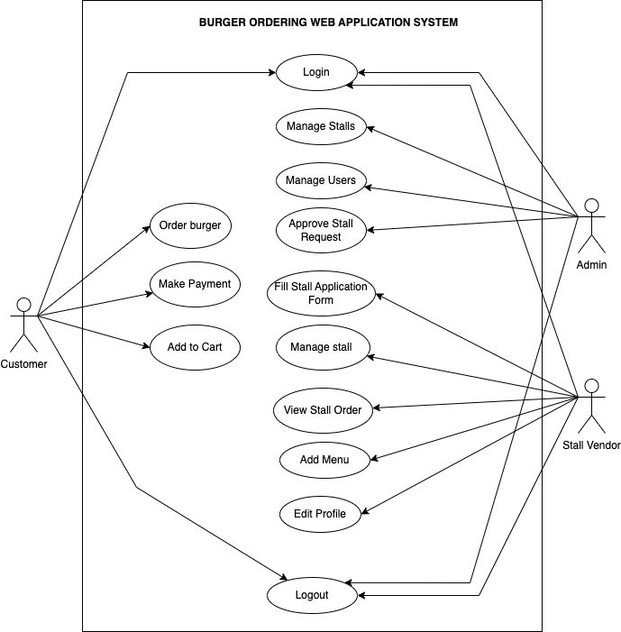
USE CASE
DIAGRAM

Slide 15
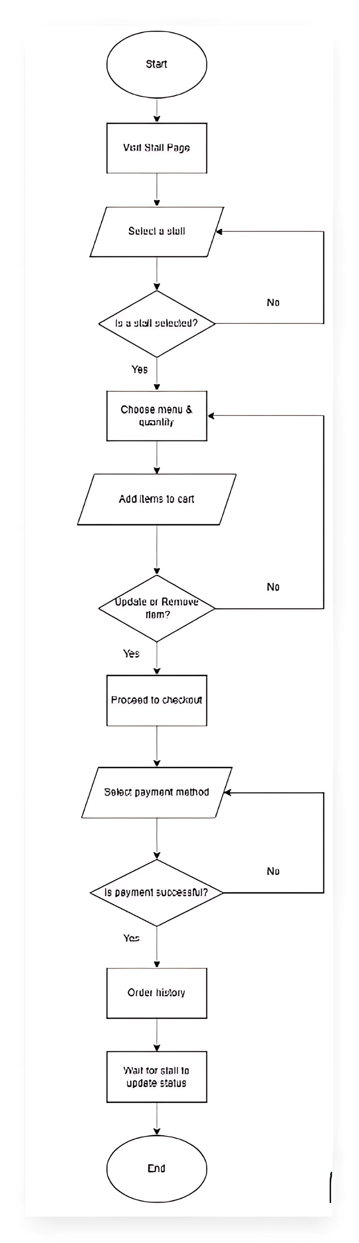
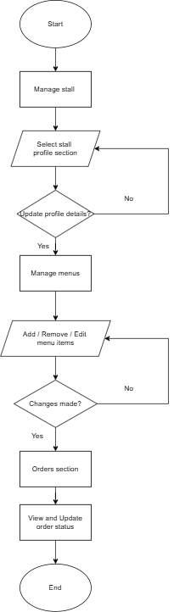
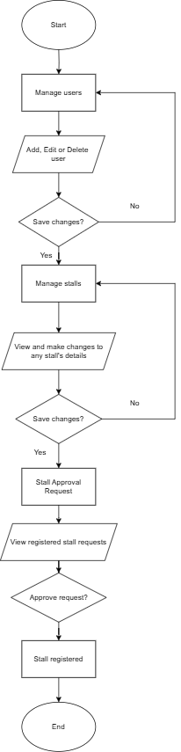
CUSTOMER
VENDOR
ADMIN

Slide 16
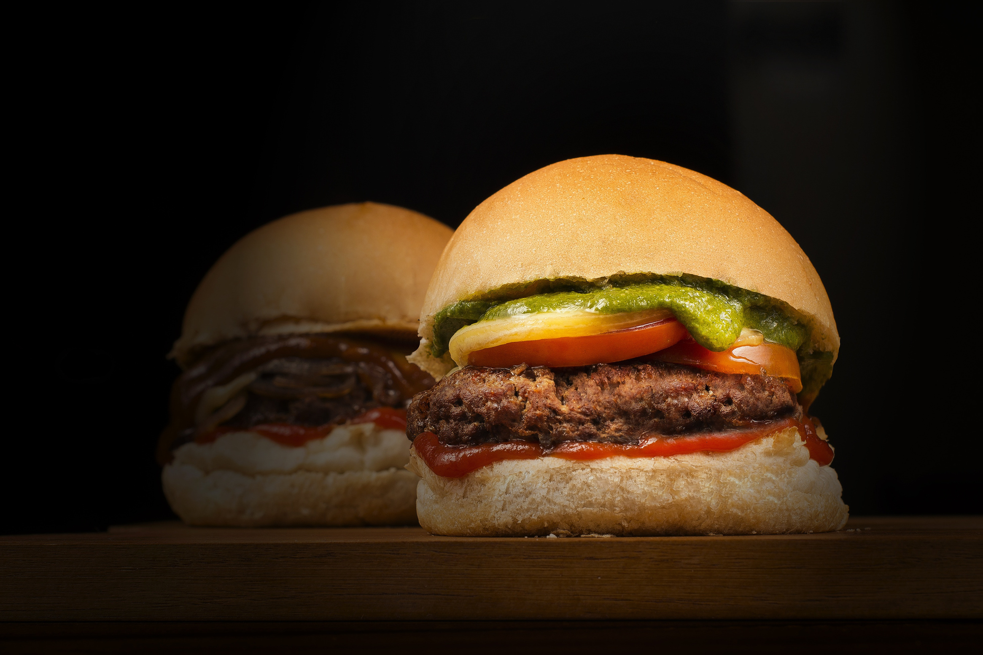
IMPLEMENTATION
THANK YOU

